Slide 1
Attributes of a Successful Nuclear Construction Project – A Regulator’s Perspective
Victor M. McCree
Deputy Regional Administrator for Operations
U.S. NRC Region II
May 20, 2010

Slide 2
Background
Last nuclear plant construction period was not a model of efficiency and effectiveness
Many delays, cancellations, major construction problems, design changes, and cost overruns
Licensing process was cumbersome, inefficient, and uncertain
Inspection process was not well structured or sufficient
Licensee’s oversight and involvement was insufficient and ineffective

Slide 3
What is Different This Time?
Approved & Current Design Certifications
10 CFR Part 52 for Licensing
ITAAC
Construction Techniques
Improved Vendor Oversight
Construction Inspection Program -- NRC Addressing Lessons Learned
Learning from International Construction Activities
Learning from New Fuel Facility Construction
Industry Success Factors

Slide 4
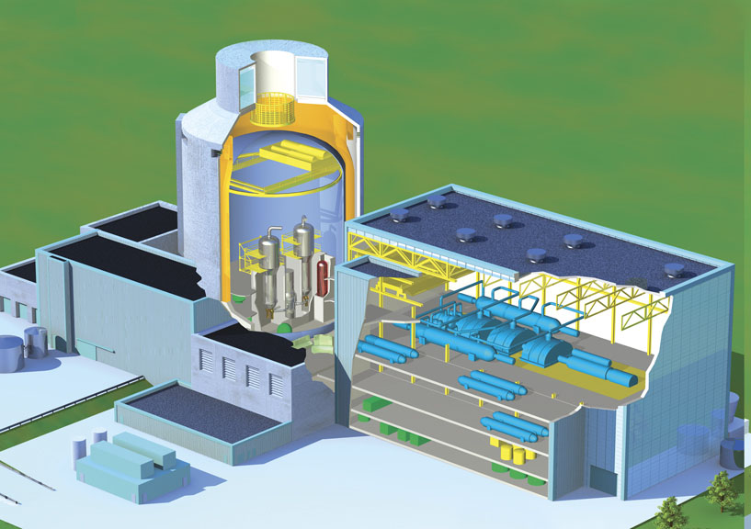
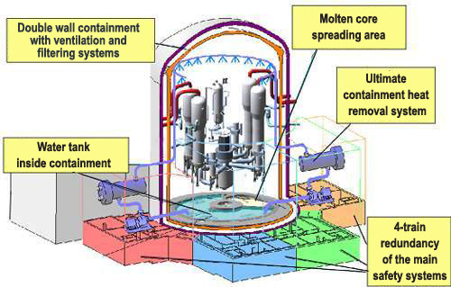
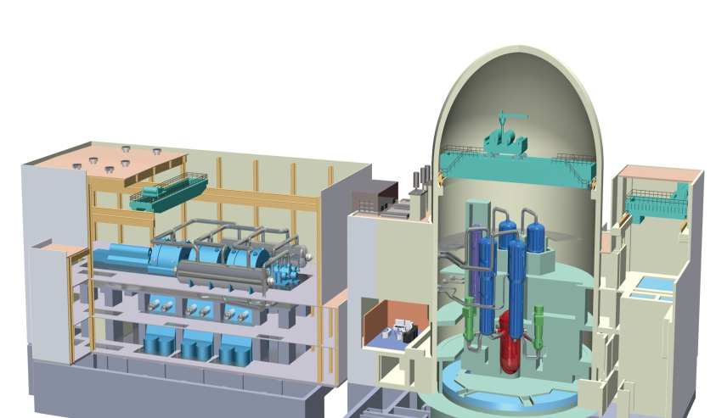
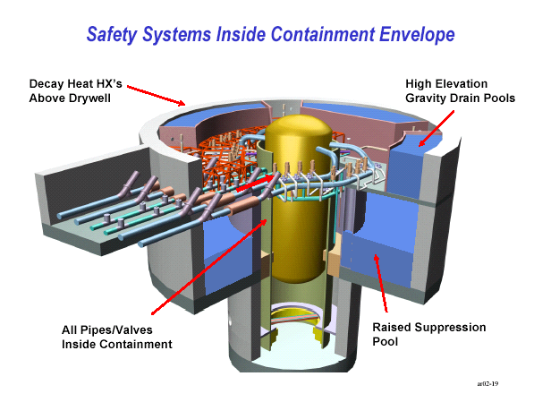
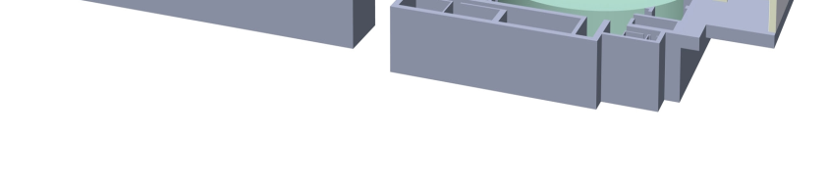
Design Certifications Under Review
AP1000
EPR
US APWR
ABWR
ESBWR

Slide 5
Goals for 10 CFR Part 52 Licensing
More predictable licensing process
Resolve safety and environmental issues before authorizing construction
Reduce financial risk to licensees
Encourage standardization of nuclear plants – choose a certified design

Slide 6
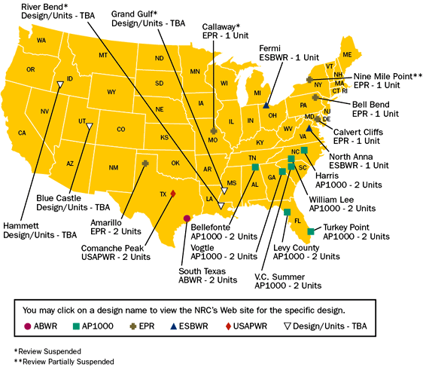

Slide 7
ITAAC
An application for a standard design certification must contain proposed inspections, tests, analyses, and acceptance criteria (ITAAC) for the standard design.
The licensee and the NRC review/inspect the ITAAC (verify ITAAC are met) to ensure that the as-built nuclear power plant is constructed and performs as intended.

Slide 8
Construction Techniques
Modular Construction
Offsite Fabrication
Onsite Assembly

Slide 9
Improved Vendor Oversight
Build upon existing vendor inspection program in coordination with other NRC offices
Increase inspection frequency and scope
Clarify oversight and improve interface with industry’s third-party auditing organization
Expand international cooperation in vendor oversight

Slide 10
Lessons Learned
“Man learns from history that man learns nothing from history.”
- Hegel’s Paradox

Slide 11
NRC Lessons Learned
Inspect early in any new process
Larger resident inspector presence
Better integration of individual findings
Prompt response to quality issues and allegations
Physical work observations rather than paper reviews
Improved inspection planning and scheduling
Closer relationship between inspection and licensing
Complete and accurate inspection record
Ensure effective corrective action program

Slide 12
Learning from International Construction Activities
China – AP1000 construction
Finland – EPR construction
France – EPR construction
Taiwan – ABWR construction
Observe New Construction Techniques – Modular Construction
Gather Lessons Learned

Slide 13
Industry Success Factors
Clear management expectations and oversight – including QA/QC
Experienced staff, vendors, contractors
Self-critical approach
Robust corrective action program
Clear communications
Early completion of detailed design
Respect for the hazard

Slide 14
Recently Revisited Lessons
Ambitious schedules
Quality assurance/quality control
Safety culture
Oversight of contractors
Active management oversight
Clear roles and responsibilities
Completed final design details

Slide 15
SUMMARY
Focus on certified designs - ensure critical design parameters are finalized before construction
Use Part 52 licensing
Ensure ITAAC are clearly met
Establish a strong QA/QC presence
Hire good staff & contractors
Safety focus is paramount – stop work when problems are encountered
Capture and address problems in a good corrective action system

